Slide 1



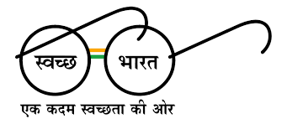


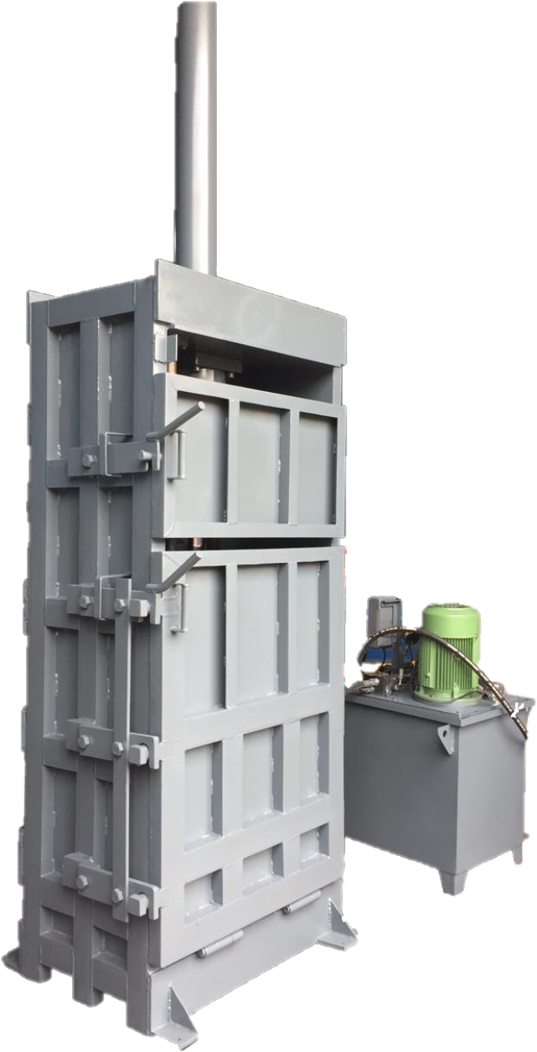
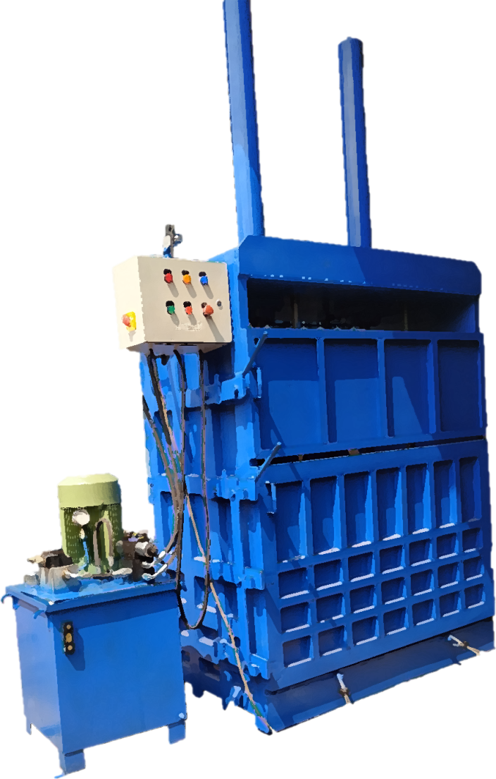
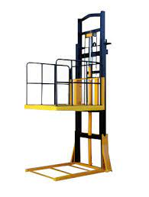
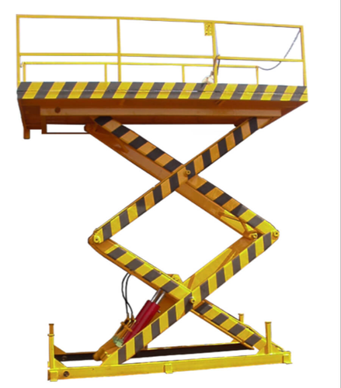
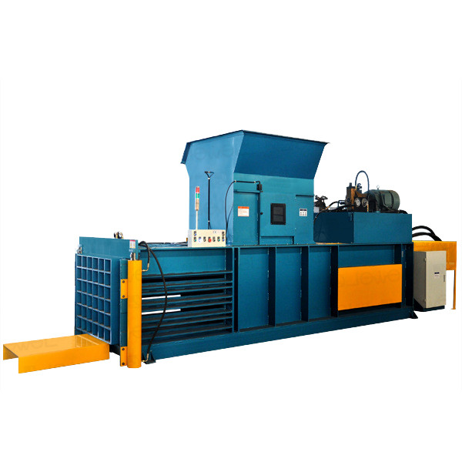
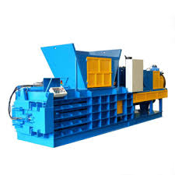
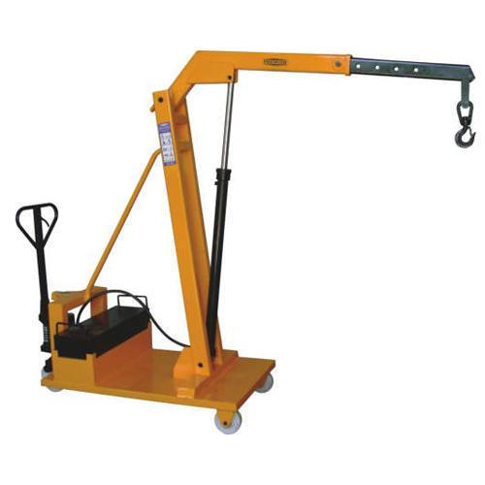
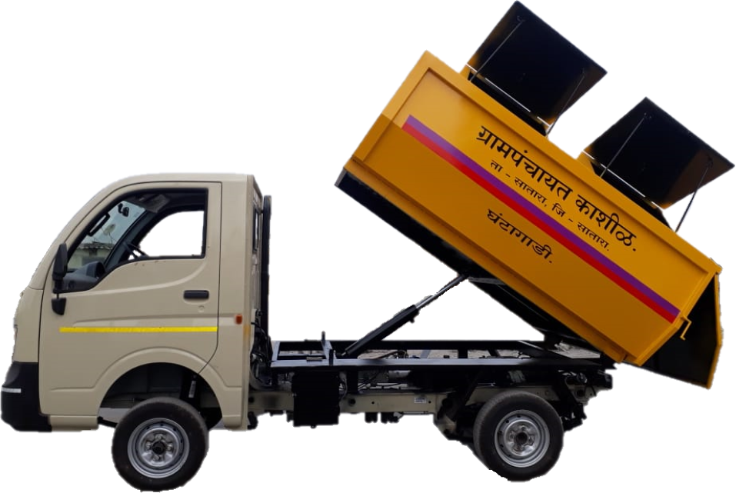
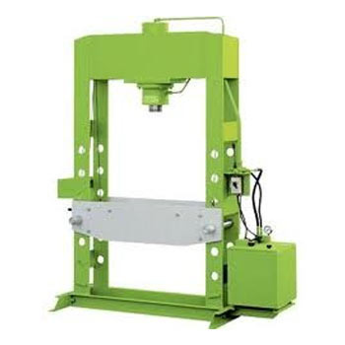
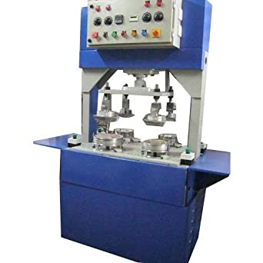
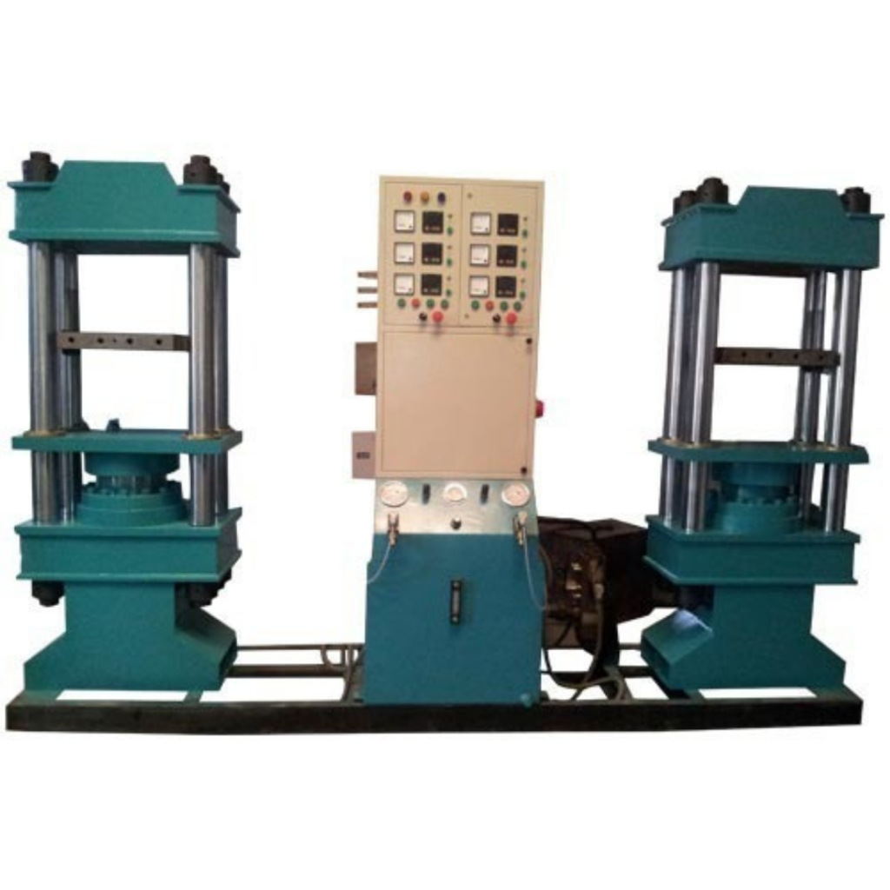
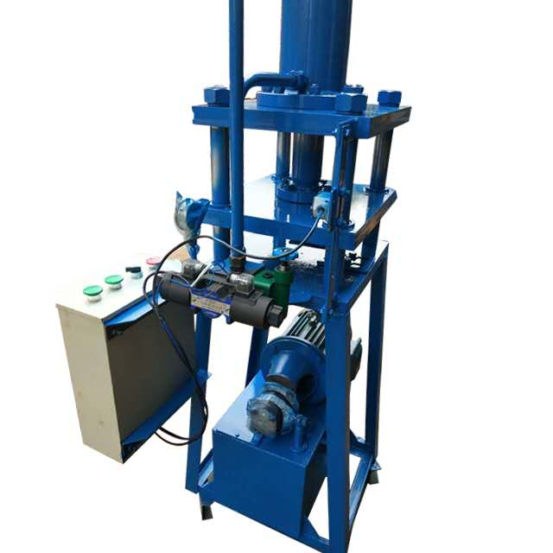
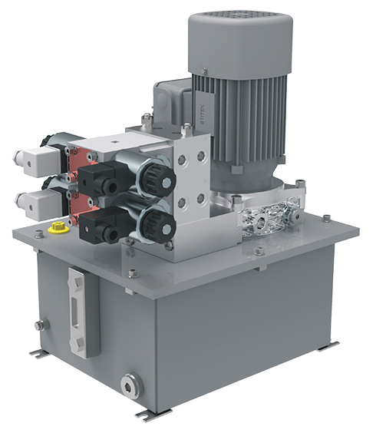
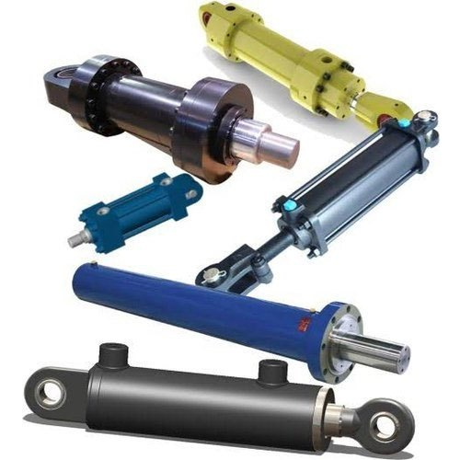
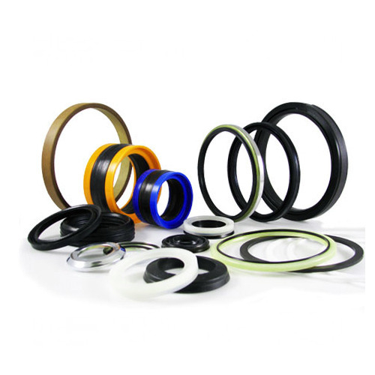
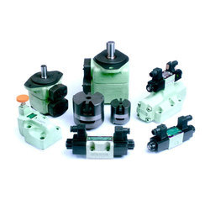
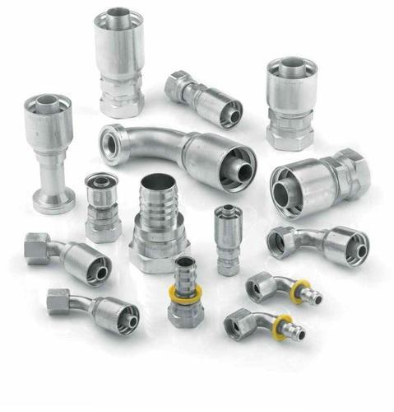
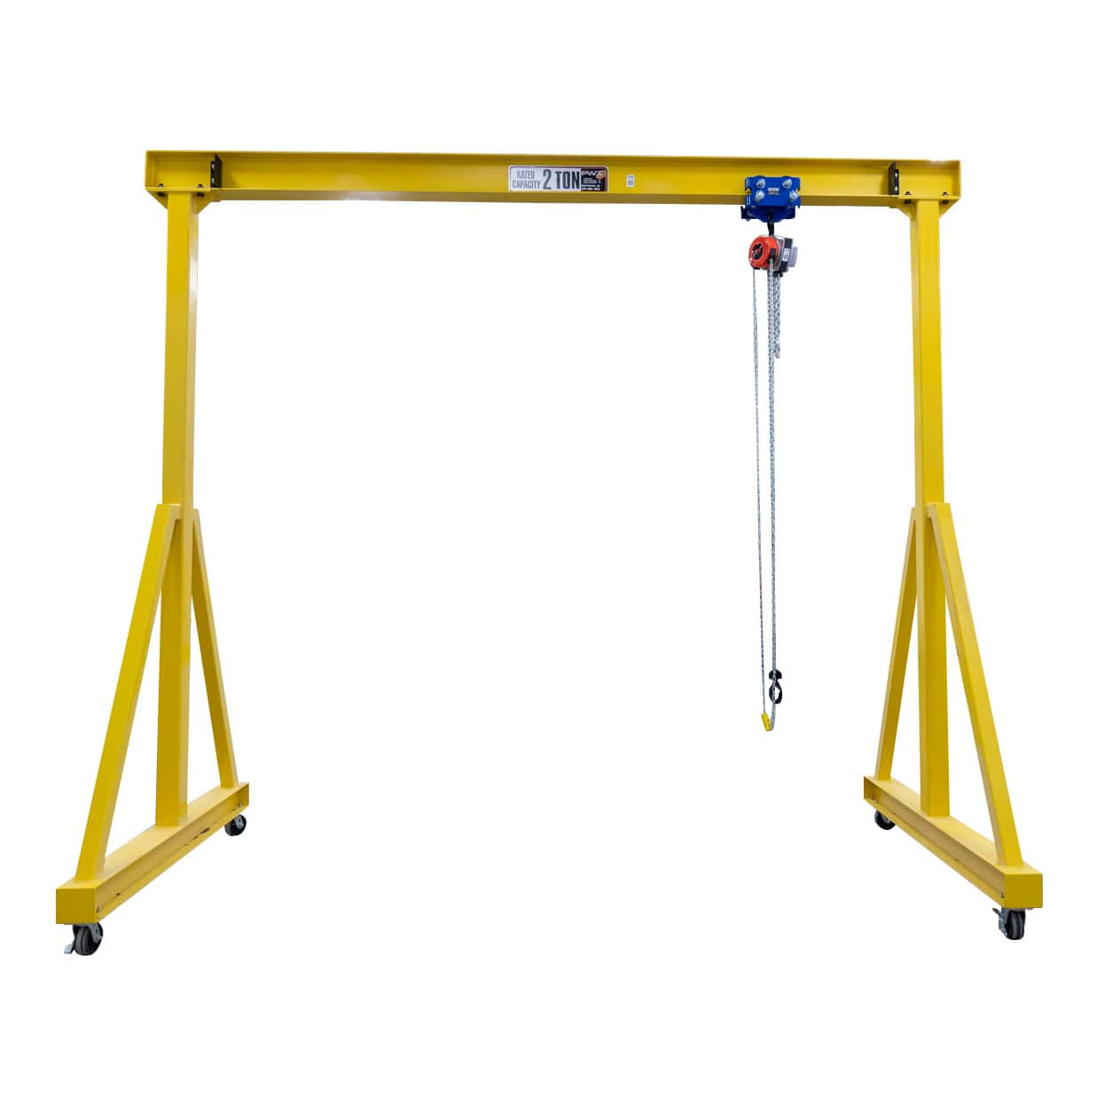
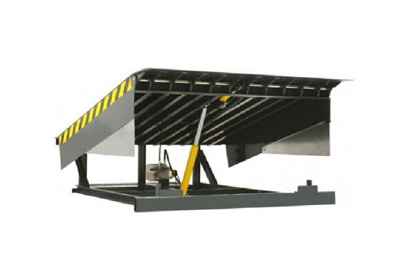

INFINITY HYDRAULICS
WE MINIMIZE YOUR EFFORTS
PRODUCT’S CATALOGUE
VERTICAL BALING PRESS
DOUBLE CYLINDER BALING PRESS
CONTINEOUS BALING
PRESS
METALLIC SCRAP BALING PRESS
GOODS LIFT
SCISOR LIFT
FLOOR CRANE
GARBAGE HOPPER/TIPPER
WORKSHOP
PRESS
PAPER PLATE
MAKING MACHINE
RUBBER
MOULDING PRESS
SPECIAL PURPOSE MACHINE
HYDRAULIC POWER PACK
HYDRAULIC CYLINDER
HYDRAULIC
SEALS
HYDRAULIC
PUMP & VALVES
We are one of the leading company in the industry, extremely efficient in offering Hydraulic Equipment’s and Services. The company's products have been widely used in printing, packaging, corrugated box, textile, food, beverage, pharmaceutical, chemical, electronics, metal, agricultural products, plastic, film edge repair, recycling and other industries, among which , the whole plant
waste discharge design concept is in many
industries received higher evaluation.
HYDRAULIC FITTINGS
GANTRIES
DOCK LIEVELLER
Every Action for Customer Satisfaction

